Slide 1

CS3233
Competitive Programming
This course material is now made available for public usage.
Special acknowledgement to School of Computing, National University of Singapore
for allowing Steven to prepare and distribute these teaching materials.
Dr. Steven Halim
Week 12 – Harder Stuffs
CS3233 - Competitive Programming,
Steven Halim, SoC, NUS
Notes:
Harder stuffs

Slide 2
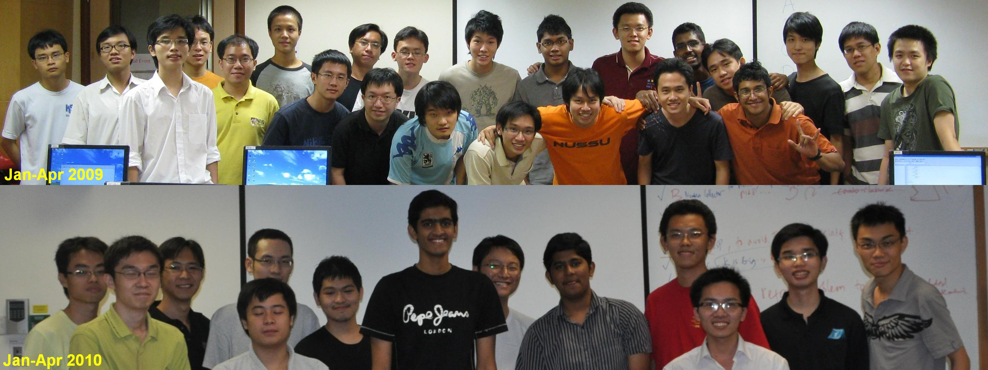
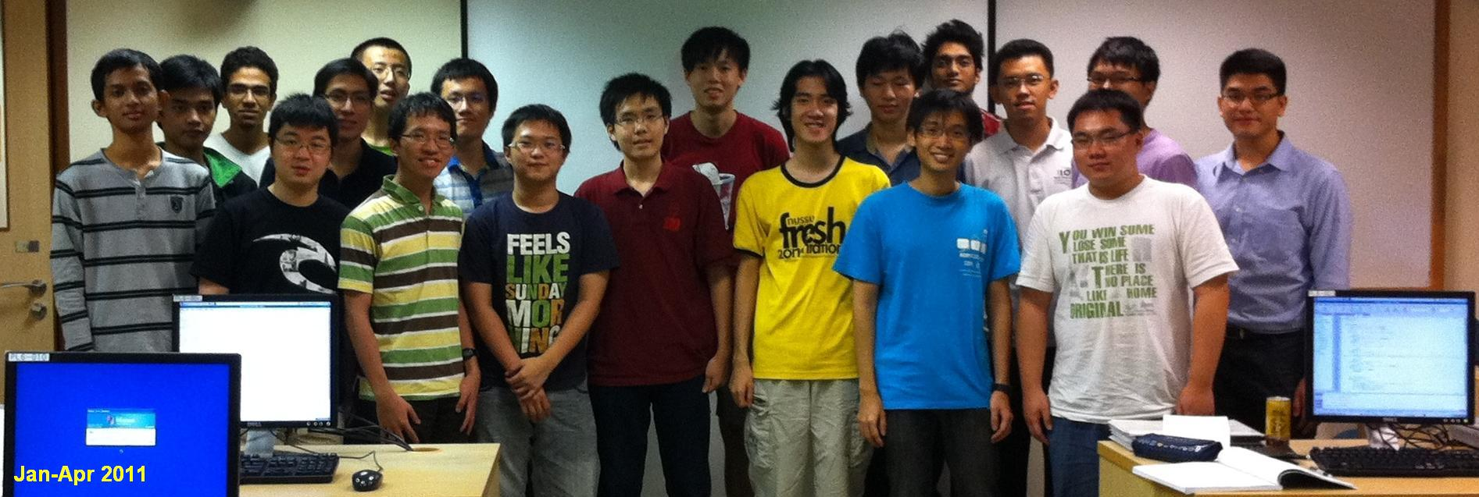
Let’s Take Class Photos NOW ☺
Important for documentation/promotional purpose
Jan-Apr 2011

Slide 3
Clicker…
Return your clicker at the end of tonight
(or latest by next week, during final contest ☺)
RI students ->
You left 5 clickers at the back of PL6 last week?
  All of them are with me now
  It is OK, we don’t have that many clicker slides tonight
CS3233 - Competitive Programming,
Steven Halim, SoC, NUS

Slide 4
Outline
Mini Contest #10 (the last one) + Discussion + Break
CLASS PHOTO!!
Admins
Last Lecture (let’s not get too ambitious):
  Problem Decomposition (Section 8.2)
  Meet in the Middle/Bidirectional Search
CS3233 - Competitive Programming,
Steven Halim, SoC, NUS

Slide 5
Final Team Contest
4 (easy-medium) problems set by Steven
  Mostly second half problems (MF, Maths, SA, Polygon), not that hard…
  I reserve some of my personal hard problems for iCode 2012 final ☺
3 problems set by Harta, 3 problems set by Phuong
  All, but… the harder ones ☺, at least 1 is “easy enough”
Worth 1.5%/problem
We set the problem set to have average 6 AC:
  Get 4 AC from all my problems, 1 from Harta, 1 from Phuong
Again, get to know your (new) team mates!
  Have lunch/dinner together to find out your team’s strengths/weaknesses
  http://xrds.acm.org/article.cfm?aid=332139
CS3233 - Competitive Programming,
Steven Halim, SoC, NUS

Slide 6
For the Guests
Again, the final-sem team contest is not counted towards
IOI 2012 selection test
  It is team based, hard to split the marks… :O
I want to try this formation
  RI1/RI2
  HCI
  NUSH
  Others
Join for fun
  This final-semester contest have mostly stuffs outside IOI syllabus ☹
CS3233 - Competitive Programming,
Steven Halim, SoC, NUS

Slide 7
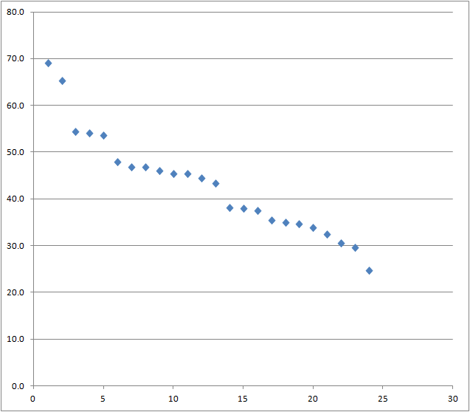
The Score Distribution (Before Mini 10)
CS3233 - Competitive Programming,
Steven Halim, SoC, NUS

Slide 8
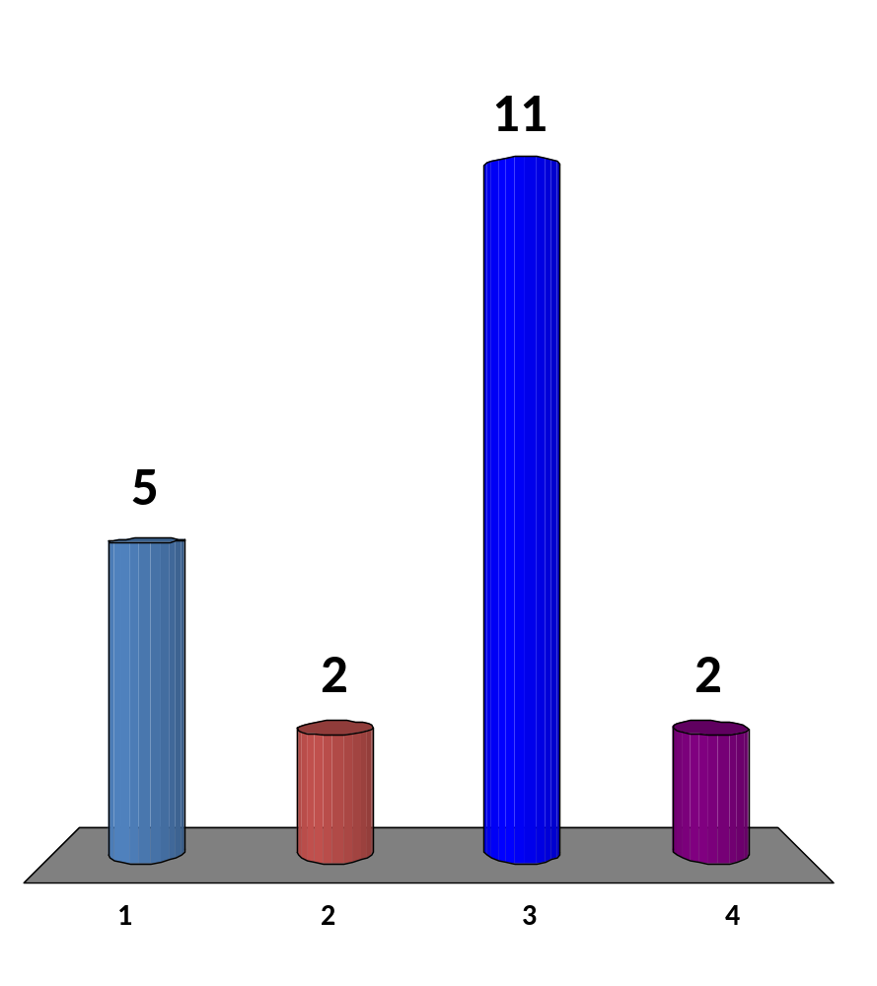
NUS Students Only
I am happy with where
I am now, but will keep pushing
I am happy with where I am now, I will relax and study other mods
I am not happy yet, I will “die die” push myself one band up (or to ensure it is ≥ 55 points) by doing as many UVa problems as possible before Sat 5 May 2012
I am not happy with where I am now but I don’t think I can do much with “UVa apprentice” either ☹
20 of 120
CS3233 - Competitive Programming,
Steven Halim, SoC, NUS

Slide 9
PROBLEM DECOMPOSITION
The harder ones
(you have seen some of these before; now, let’s demistify some of them)
Soft skills needed:
Ability to spot the individual components and break them apart!
This is based on what I know from ~ 1422 UVa problems
CS3233 - Competitive Programming,
Steven Halim, SoC, NUS

Slide 10
Problem Decomposition (1)
Binary Search the Answers + X
We have seen this form earlier (Chapter 3.3)
But the “X” component of this ‘classical’ combination can be “many thing”, not just simulation problem
So far, I have seen that X can be:
  Greedy algorithm: UVa 714, 11516
  MCBM: UVa 10804, 11262
  SSSP: UVa 10186
  Max Flow: UVa 10983
Tips to spot this type: If you guess the answer,
will the problem turn into a True/False problem?
CS3233 - Competitive Programming,
Steven Halim, SoC, NUS

Slide 11
Problem Decomposition (2)
Involving DP 1D Range Sum/Max/Min
This one can be easily decomposed
Tips to spot this type:
The problem ask you for static range queries
  Especially the 1D one
  Usually range sum, but can also be max/min queries, how?
Range Sum Query: Pre-process the answers in O(n)
  dp[0] = ans[0]
  dp[i] = dp[i-1] + ans[i] ∀ i ∈[1..n-1]
So that each RSQ can be answered in O(1)
  rsq(i, j) = dp[j] if i == 0, or dp[j] - dp[i - 1] if j > 0
CS3233 - Competitive Programming,
Steven Halim, SoC, NUS

Slide 12
Sparse Table for
Static Range Min/Max Query
To be added in the future ☺
CS3233 - Competitive Programming,
Steven Halim, SoC, NUS

Slide 13
Problem Decomposition (3)
SSSP/APSP + DP/Something else
Another ‘classical’ combination is to use shortest path as one sub problem to transform the original problem into a shortest path table, then pass this table to a DP solution/other technique
  BFS/Dijsktra’s to build shortest path matrix → DP-TSP
  (UVa 10937, 10944, 10405, 11813, NOI 2011)
  Run Dijkstra’s algorithm → build DAG from SP information →
  Counting paths on DAG (UVa 10917)
  Run Floyd Warshall’s algorithm → do something else
  (UVa 1233, 10793, 11463)
Tips to spot this type: Shortest path is
one of the component, but not the only one…
CS3233 - Competitive Programming,
Steven Halim, SoC, NUS

Slide 14
NOI 2011, TOUR (1)
http://www.comp.nus.edu.sg/~noi/2012/tasks.html
Input:
3 5
~.~.~
6.~5.
~..C~
Transform input into a 15x15 distance table dist (adjacency matrix) using BFS (because the graph is unweighted)
 | C | Att Spot 1 (5) | Att Spot 2 (6)
C | 0 | 1 | 4
Att Spot 1 (5) | 1 | 0 | 5
Att Spot 2 (6) | 4 | 5 | 0
CS3233 - Competitive Programming,
Steven Halim, SoC, NUS

Slide 15
NOI 2011, TOUR (2)
Do DP-TSP from Changi ‘C’ (index 0), but with two twists:
  You can go ‘home’ early :O
  This is a maximizing problem, not minimizing…
Solution:
  State: same as original DP-TSP
    dp[pos][bitmask]
  Space Complexity: N*2^{N}, N is just 14+1 = 15, do-able ☺
  Transition:
    dp[pos][bitmask] = dist[pos][0] * -2 if bitmask is all ‘1’s…
    dp[pos][bitmask] = max(dist[pos][0] * -2, // if I just go home ‘C’ early
    (dist[pos][nxt] * -2 + S[nxt]) + dp[nxt][bitmask with nxt turned on])
    for all nxt != pos and nxt is previously off in bitmask
  Time Complexity: N*2^{N} * N = N²*2^{N}, N is 15, do-able ☺
CS3233 - Competitive Programming,
Steven Halim, SoC, NUS

Slide 16
Problem Decomposition (4)
X + Y
Here, X is the “main issue”
  But that problem is written in Y flavour
Tips to spot this type: Usually,
  X is either: BFS, Complete Search, Binary Search,
  (mostly Chapter 3 stuffs), and
  Y is either: Graph, Mathematics, or Geometry
  (mostly Chapter 4-5-7 stuffs)
Example: UVa 11730
  Actually a BFS (SSSP on unweighted graph) problem
  But the graph is implicitly derived via Mathematical rules
CS3233 - Competitive Programming,
Steven Halim, SoC, NUS

Slide 17
Problem Decomposition (5)
Involving (Advanced) Data Structures/DS
Tips to spot this type: If you got a problem “AC”
but very slow (TLE)
Consider the possibility that some operations in your algorithm can be optimized by using a better DS
  This better DS are usually harder to implement though
These DSes are usually:
  Balanced BST: map/set,
  or the self-coded one due to the need to augment data
  Binary Indexed (Fenwick) Tree
  Segment Tree, etc
CS3233 - Competitive Programming,
Steven Halim, SoC, NUS

Slide 18

Problem Decomposition (6)
Three (or More?) Components
UVa 1079 – A Careful Approach
  http://uva.onlinejudge.org/external/10/1079.html
  ACM ICPC World Finals 2009 problem
Solution:
  Complete Search + Binary Search the Answer + Greedy :O
CS3233 - Competitive Programming,
Steven Halim, SoC, NUS

Slide 19
Problem Decomposition (7)
There are many other possible combinations…
Note: If there are X basic types of contest problems…
  There can be _{X}C₂ possible pairs of combinations
  And there can be _{X}C₃ triples…
You will get more familiar to spot the individual components as you master them
  All the best
CS3233 - Competitive Programming,
Steven Halim, SoC, NUS

Slide 20
IDA* Search
To be added in the future ☺
CS3233 - Competitive Programming,
Steven Halim, SoC, NUS

Slide 21
MEET IN THE MIDDLE
a.k.a. Bidirectional Search
CS3233 - Competitive Programming,
Steven Halim, SoC, NUS

Slide 22
UVa 11212 – Editing a Book
Rujia Liu’s Problem
Given n equal-length paragraphs numbered from 1 to n
Arrange them in the order of 1, 2, ..., n
With the help of a clipboard,
you can press Ctrl-X (cut) and Ctrl-V (paste) several times
  You cannot cut twice before pasting, but you can cut several contiguous paragraphs at the same time - they'll be pasted in order
The question: What is the minimum number of steps required?
Example 1: In order to make {2, 4, (1), 5, 3, 6} sorted,
you can cut 1 and paste it before 2 → {1, 2, 4, 5, (3), 6}
then cut 3 and paste before 4 → {1, 2, 3, 4, 5, 6} → done √
Example 2: In order to make {(3, 4, 5), 1, 2} sorted,
you can cut {3, 4, 5} and paste it after {1, 2} → {1, 2, 3, 4, 5} √
or cut {1, 2} and paste it before {3, 4, 5} → {1, 2, 3, 4, 5} √
CS3233 - Competitive Programming,
Steven Halim, SoC, NUS

Slide 23
Loose Upper Bound
Answer: k-1
  Where k is the number of paragraph in the wrong position
Trivial but wrong algorithm:
  Cut a paragraph that is in the wrong position
  Paste that paragraph in the correct position
  After k-1 such cut-paste, we will have a sorted paragraph
    The last wrong position will be in the correct position at this stage
  But this may not be the shortest way
Examples:
  {(3), 2, 1} → {(2), 1, 3} → {1, 2, 3} → 2 steps
  {(5), 4, 3, 2, 1} → {(4), 3, 2, 1, 5} → {(3), 2, 1, 4, 5} → {(2), 1, 3, 4, 5} →
  {1, 2, 3, 4, 5} → 4 steps
CS3233 - Competitive Programming,
Steven Halim, SoC, NUS

Slide 24
The Actual Answers
{3, 2, 1}
  Answer: 2 steps, e.g.
    {(3), 2, 1} → {(2), 1, 3} → {1, 2, 3}, or
    {3, 2, (1)} → {1, (3), 2,} → {1, 2, 3}
{5, 4, 3, 2, 1}
  Answer: Only 3 steps, e.g.
    {5, 4, (3, 2), 1} → {3, (2, 5), 4, 1} → {3, 4, (1, 2), 5} → {1, 2, 3, 4, 5}
How about {5, 4, 9, 8, 7, 3, 2, 1, 6}?
  Answer: 4, but very hard to compute manually
How about {9, 8, 7, 6, 5, 4, 3, 2, 1}?
  Answer: 5, but very hard to compute manually
CS3233 - Competitive Programming,
Steven Halim, SoC, NUS

Slide 25
Some Analysis
There are at most n! permutations of paragraphs
  With maximum n = 9, this is 9! or 362880
  The number of vertices is not that big actually
Given a permutation of length n (a vertex)
  There are _{n}C₂ possible cutting points (index i, j ∈ [1..n])
  There are n possible pasting points (index k ∈ [1..(n-(j-i+1))])
  Therefore, for each vertex, there are about O(n³) branches
The worst case behavior if we run single BFS on this search space graph: O(V+E) = O(n! + n!*n³) = O(n!*n³)
  With n = 9, this is 9! * 9³ = 264539520 ~ 265 M, TLE (or maybe MLE…)
CS3233 - Competitive Programming,
Steven Halim, SoC, NUS

Slide 26
BFS from Source s Only
s
t
CS3233 - Competitive Programming,
Steven Halim, SoC, NUS

Slide 27
Meet in the Middle a.k.a. Bidirectional Search
When we run BFS from ending state (permutation 1,2,3,…,n=9) to reach all other states, we found out that for this particular problem, the maximum depth for n = 9 is just 5 (after running it for a few minutes)
  i.e. the “diameter” of this search space graph is 5
This information allows us to perform bidirectional BFS by choosing only to go to depth 2 from each direction… :O
See the illustration in the next slide
CS3233 - Competitive Programming,
Steven Halim, SoC, NUS

Slide 28
BFS from target t
(max depth of BFS is 2)
s
t
Case 1
Source s is already found just by running BFS from target t with maximum depth 2 (answer: 1 or 2 steps)
CS3233 - Competitive Programming,
Steven Halim, SoC, NUS

Slide 29
BFS from Source s and Target t
(max depth of both BFS is 2)
s
v
t
Case 2
There is a common vertex v that is within two layers away
from t and from s (answer: dist[s][v] + dist[v][t] steps,
or in a more familiar notation: d_{s}[v] + d_{t}[v])
CS3233 - Competitive Programming,
Steven Halim, SoC, NUS

Slide 30
BFS from Source s and Target t
(max depth of both is 2)
s
t
Case 3
There is a no common vertex that is within two layers away from t and from s (answer: clearly 5 steps as s and t must always be reachable, notice that doing this allows us to skip computing the third layer, which is much larger than the second layer)
CS3233 - Competitive Programming,
Steven Halim, SoC, NUS

Slide 31
Implementation Strategy
(PseudoCode, the source code is shown briefly)
BFS from target t (sorted paragraphs: 1, 2, 3, …, n) only ONCE, and store the distance information from target t to all vertices with depth 2 in table ‘d’
  How to stop BFS after only depth 2?
    Answer: Check d[u] just as you pop up u from the queue
Now, BFS from source s, also with maximum depth 2
  Assume we are at vertex u which is L-depth away from s
  If vertex u is inside table ‘d’ (MEET IN THE MIDDLE!)
    We immediately return L + d[v]
  Use the same BFS code for both directions to avoid unwanted bugs…
If we cannot find any common vertex when doing BFS from target t and from source s, we simply return 5 (cool ☺)
CS3233 - Competitive Programming,
Steven Halim, SoC, NUS

Slide 32
Another Analysis
We have seen that given a permutation of length n (a vertex)
  There are about O(n³) branches
If we just run BFS with at most depth 2 (MAJOR speedup)
  We have at most O((n³)²) = O(n⁶)
  With n = 9, this is 9⁶ = 531441 (this is greater than 9!, many overlaps!)
We only compute BFS from target t once
We compute BFS from source s per query
  With additional log factor due to the usage of table data structure
  (e.g. map)
This is clearly much faster than single-directional search
  9! * 9³ = 264539520 ~ 265 M, TLE (or maybe MLE…)
  9⁶ + Q * 9⁶ = doable
CS3233 - Competitive Programming,
Steven Halim, SoC, NUS

Slide 33
When to use “Meet in the Middle”?
(this is an interactive slide → points)
If single-directional search leads to correct answer
but awfully slow… TLE or MLE
If you know your target state
(otherwise you cannot search from the other direction)
The graph is undirected (a.k.a. bidirectional) with
the cost of going forward = cost of going backwards (otherwise WA)
You know the upperbound (otherwise you can’t cut it into half)
You can find the intersection between two shortest path spanning tree easily (e.g. with table data structure/balanced BST or hashing)
You are not required to output the full shortest path,
harder (but not impossible) otherwise
You are confident with your coding skill… :O
CS3233 - Competitive Programming,
Steven Halim, SoC, NUS

Slide 34
SOME PARTING WORDS
Actually we will still meet again next week for final contest :D
CS3233 - Competitive Programming,
Steven Halim, SoC, NUS

Slide 35
What You Have Been Exposed To
(as of Tonight, Wed 04 Apr 2012)
Competitive Coding Style
Extensive usage of libraries
Bitmask
BIT/FT
Iterative BF Techniques:
Subset, Permutation
Recursive backtracking
Some classical Greedy problems
Binary Search the Answer
The thinking process to get DP states and transitions
Graph DS, Traversal: DFS/BFS, MST (briefly), SSSP: Dijkstra’s, Bellman Ford’s, APSP: Floyd Warshall’s
Tarjan’s SCC algorithm
More DP techniques
Network Flow: Edmonds Karps’
Bipartite Graph: MCBM++
Mathematics-related problems: Log techniques, Big Integer, Prime Factor techniques, Modulo arithmetic
Various string processing skills
Suffix Tree/Array: String Matching, Longest Repeated Substring,
Longest Common Substring
Basic geometry routines
Algorithms on polygon
Problem decomposition
Meet in the middle/bidirectional search
CS3233 - Competitive Programming,
Steven Halim, SoC, NUS

Slide 36
What You Have NOT Been Exposed To
(as of Tonight, Wed 04 Apr 2012)
Many more cool and exotic algorithms out there :O
Maybe read CP3 in the future ☺
Or join NUS ACM ICPC trainings
Or do self study
CS3233 - Competitive Programming,
Steven Halim, SoC, NUS

Slide 37
ACM ICPC 2012
World Finals in Warsaw, Poland
  Support your TAs: Harta, Phuong, and Zi Chun
  14-18 May 2012
NUS internal selection tests 2012
  Sometime around September 2012 (before/around recess week of S1 AY2012/2013)
Regional contests 2012
  Maybe your turn?
CS3233 - Competitive Programming,
Steven Halim, SoC, NUS

Slide 38
iCode 2012
Next Saturday, 14 April 2012, PL6
  Individual contest
  Can be a hard contest, 6 ICPC 2012 world finalists are there
Eligible contestants from this sem’s CS3233
will be emailed soon (sometime next week)
All the best ☺
CS3233 - Competitive Programming,
Steven Halim, SoC, NUS

Slide 39
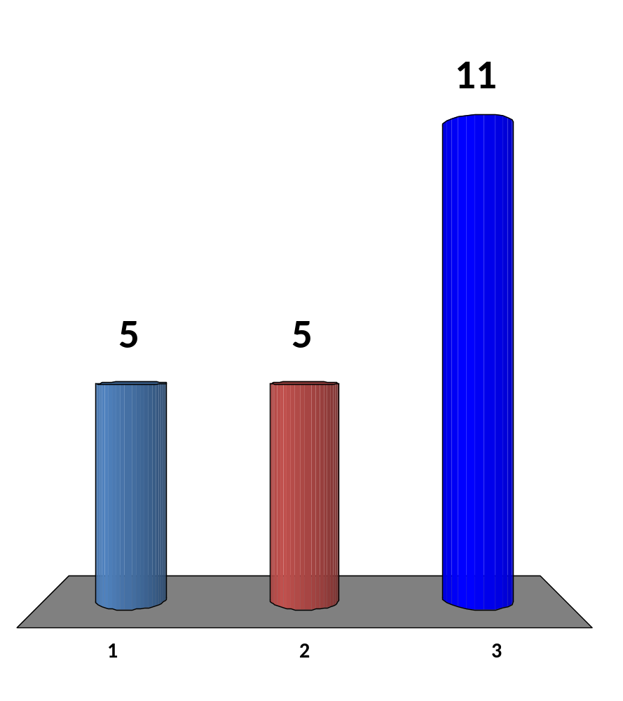
That’s the end… :O,
What is your feeling now?
A huge relief… this heavy module is “nearly over”
Neutral?
A loss… I need more algorithmic knowledge :O, teach me more!!
21 of 120
CS3233 - Competitive Programming,
Steven Halim, SoC, NUS

Slide 40
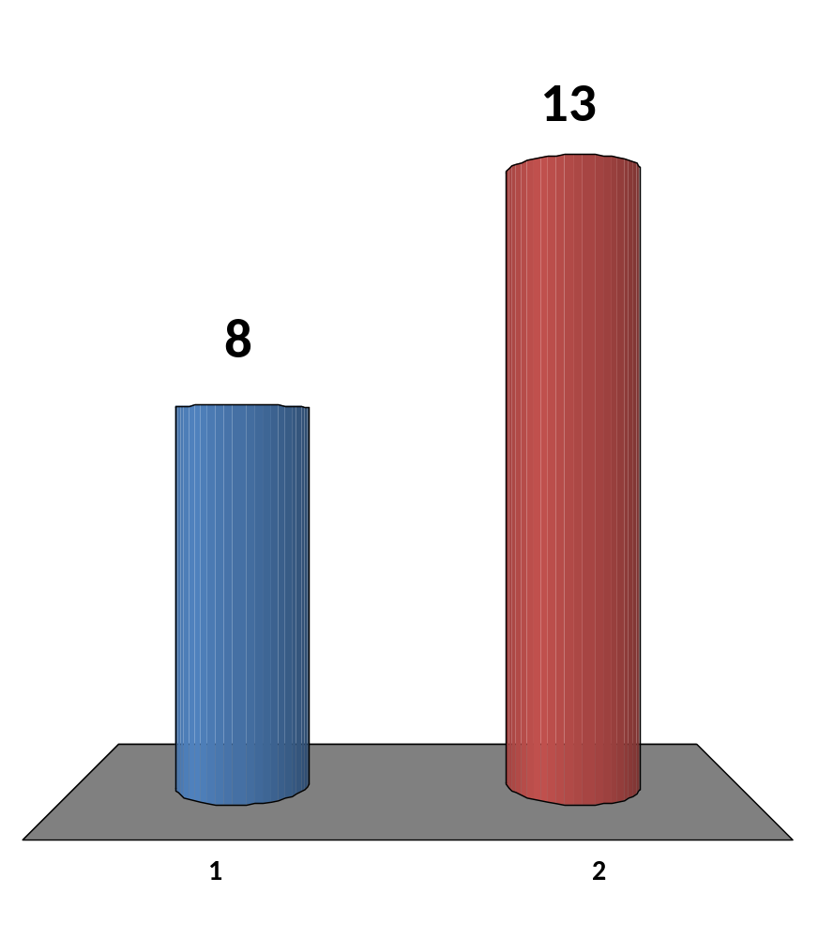
Will you recommend this module to your (suitable) juniors/friends?
No, save them from this kind of “torture”
Yes, this is a good module, some of my juniors/friends will like it
21 of 120
CS3233 - Competitive Programming,
Steven Halim, SoC, NUS

Slide 41
That’s all
For proper and formal feedbacks,
Please fill in the NUS online teaching feedback for CS3233 (the module) and for me/Harta/Phuong (the teaching staffs)
We need your valuable and honest inputs
One more slide after this → your HW
CS3233 - Competitive Programming,
Steven Halim, SoC, NUS

Slide 42
HW11 (due next Wed 11.59am!)
This is the LAST one (HW12/Survey was done)
  Go to: http://uhunt.felix-halim.net/id/32900
  Solve UVa 11212 – Editing a Book by using Meet in the Middle strategy
  If you have solved these problems in the past, fine, we will count it as “homework part A done”
Solve problem C (Cones) from today
  EMAIL to Harta directly: harta.wijaya.11.10@gmail.com
Write a report on Chapter 8 (all… you will need some time to read it :O)
  Upload to IVLE Workbin, “CP2 Review”
Potential Achievements
  Chapter 7 diversity: Solve four starred problems from different category in chapter 7 by the end of Week12
  Chapter 8 diversity: Solve four starred problems from different category in chapter 7 by the end of Week13
  Super diligent: Solve at least 13 weeks*10/week = 130 UVa problems by the end of Week13 and obtain Chapter 1-2-3-4-5-6-7-8 diversity

